Slide 1
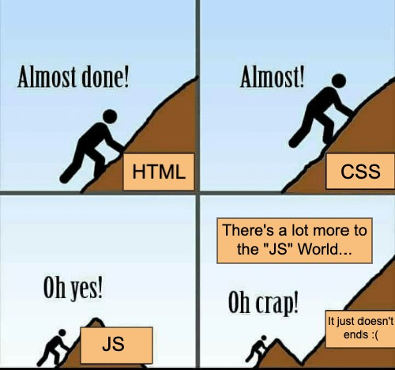
Hello World
To the real “JS” world

Slide 2
Reality Checkq
Do all websites just use HTML, CSS & JS as its technology stack for frontend part ?
Nowadays JS frameworks & libraries are extensively used in a front end app(ReactJS, Angular, NodeJS etc.)
Does JS runs only within a browser ?
JS can be used outside of browser using NodeJS - terminal, server side, compression & deployment etc.
Is JS just used to add interactivity to your web apps ?
JS can be used to generate HTML(using EXT JS or ReactJS), mobile development(hybrid as well as native using React Native etc.), compression(using gulp) and a lot more.

Slide 3
What we’ll learn
Learn the basics of NodeJS - useful for understanding setup of modern UI codebase like React
What is npm ?
What are “npm” packages ? - installing & using packages
Creating a basic NodeJS application
What is “package.json” & how it differs from “package-lock.json” ?
“npm” vs “npx”
What goes in “node_modules” directory ?
Difference between “global” & “local” packages/modules.
Running custom script using “npm”
require() vs import

Slide 4
Purpose & Introduction to NodeJS
Purpose 1- Many modern javascript codebase have the basic NodeJS like structure with a “package.json”, “package-lock.json”, “node_modules” etc. So it’s important to understand basics.
Purpose 2 - Using packages created by other developers can reduce a lot of development time. These packages continue to evolve, mostly free & open-source, and have a great community dealing with popular packages.
So NodeJS is simply “Javascript out of browser”. Precisely it’s an asynchronous event-driven JavaScript runtime.
Designed to build scalable network applications. Popularly used for server side programming like creating REST API etc.
Using NPM packages, numerous business requirements can be fulfilled for wide range of domains.
After installation, NodeJS is shipped with “npm” & both can be used as a CLI command.

Slide 5
What is npm ? How to Get Started ?
The Node Package Manager (npm) is a command-line tool used by developers to share and control modules (or packages) of JavaScript code written for use with Node.js.
Install NodeJS - https://nodejs.org/en/download/ (preferring the LTS version)
After installation, open your terminal & run command - “node -v”
Also run, “npm -v” - as npm ships with node
If node is successfully installed, above commands will output the corresponding versions.
Creating a project - Run “npm init” - it initialises a new node project in current directory & creates a “package.json” file.
“npm init” - Interactively asks few details about the project & adds them to “package.json” file
Install a npm package - Run command pointing to root of project “npm install <package-name>”. For e.g - “npm install express” or shorthand “npm i express”.
Install command creates a “node_modules” directory(if not present), downloads the package(latest version) in “node_modules/” & registers its version in “package.json”
Use pattern - “npm i <package-name>@<version>” - for using a particular version of package
Read more about npm - https://docs.npmjs.com/about-npm/

Slide 6
package.json
Center of any NodeJS project
Lists the package dependencies for your project
Consists of a single JSON object where information is stored in key-value pairs.
Acts as a blueprint for packages installed as every package installed is automatically added.
Once all the required packages are installed, “package.json” can be used to re-install or by other developers.
Contains metadata of project like author, version, package name, licence etc.
dependencies - Key of package.json for production dependencies i.e which will be included in production build by bundler like webpack etc. Value is an object containing dependencies as properties. By default packages go under these unless explicitly specified as a dev dependency.
devDependencies - Contains object with developer dependencies as properties. Will not be included in prod build. Unit testing packages like enzyme can be an example of dev dependency. “--save-dev” or “-D” can be supplied as option to denote dev dependency. E.g - “npm i -D enzyme”
Version prefixes - ^(allows update for future minor/patch version), ~(only future patch versions)
Exact version can be specified to avoid any breaking change in latest releases.

Slide 7
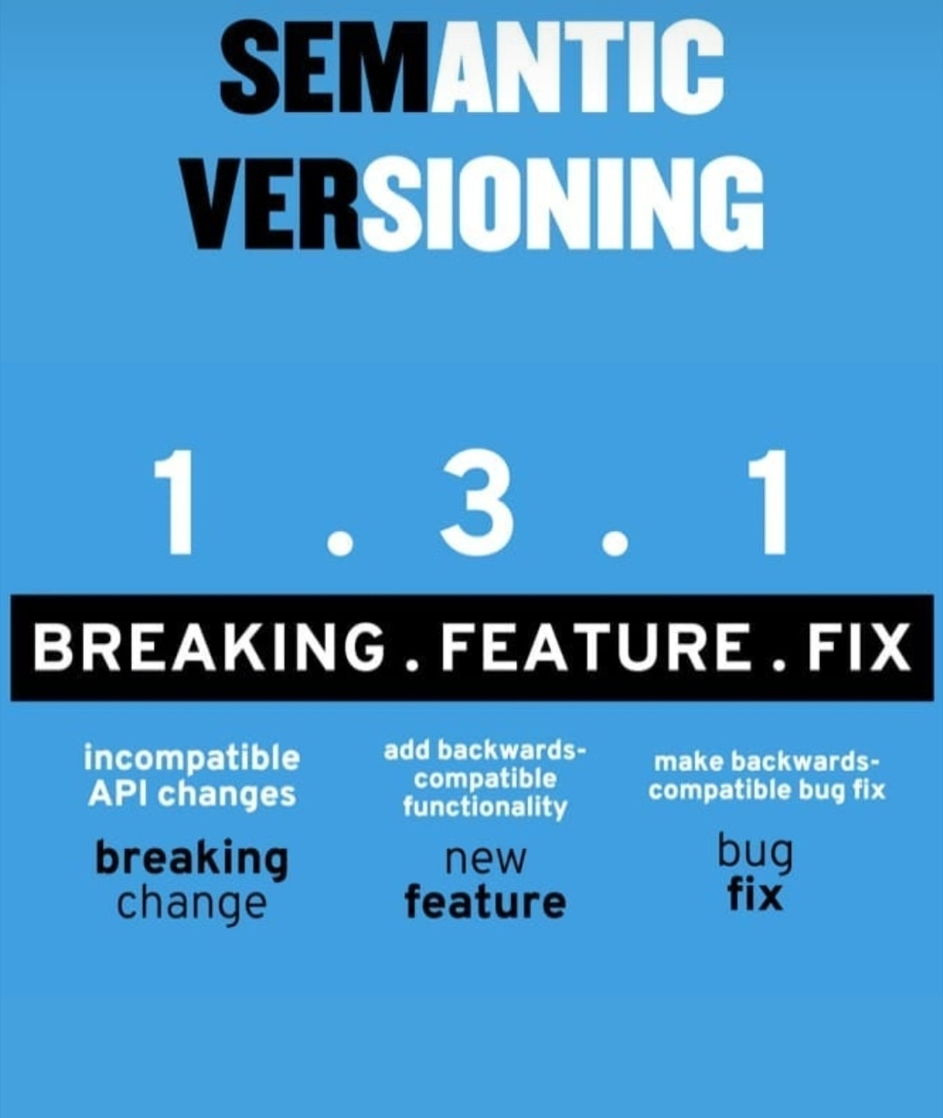
#
S
EMV
E
R

Slide 8
Using npm package
index.js (Example for creating an express app)
var express = require(‘express’); <--- Importing installed package
var app = express(); <--- using the fetched package
var port = process.env.PORT || 3000;
app.listen(port, () => { console.log(“Running on port ”, port); });
Notes:
https://drive.google.com/drive/folders/1IZAwszdkaLJmTLYO0_z9mYo2rIPDiOZN?usp=drive_link

Slide 9
package.json -vs- package-lock.json
package.json
Contains approximate(^ & ~) version of installed dependency(npm package)
Has no log for required dependencies(transitive) for any project dependency
No harm in modifying as per need, but carefully. Easy to manage.
Exact “node_modules” folder structure cannot be re-created using just “package.json” due to lack of exact version.
package-lock.json
Contains exact log of which version of dependency is actually installed currently
Contains a list of required dependencies along with their semver for any particular project dependency
Not recommended to modify at all, as may create conflicts. Long & cumbersome.
Exact “node_modules” folder structure can be re-created using “package-lock.json”.

Slide 10
Installing packages “Globally”
Globally installed packages are common to all projects. Local dependencies are just isolated to particular projects.
Globally installed dependencies go under “node_modules” directory usually at root/home level like “usr/local/lib” in Linux/Mac & “AppData/” in Windows OS
While installing dependencies “--global” or “-g” options can be passed to install command to install it globally. E.g - “npm i -g sass”
Globally installed dependencies usually can be used as a CLI command in terminal like “tsc”(typescript), “create-react-app” etc.
May face read/write related permission while dealing with global dependencies & may require frequent usage of “sudo” prefix.
“npm list -g“ command gives list of all global dependencies along with installation path
Recommended usage is to keep global dependencies count to minimal to avoid global clutter affecting all projects

Slide 11
What is npx? How is it different from npm?
“npx” is a tool to execute packages. “npm” is a tool used to install packages.
npx is shipped with newer versions of node along with npm.
npx is used to directly execute package binary without actually installing them.
Looks local or global cache for the package if already installed. Otherwise just executes the package specified(installing any required package prior to execution)
For Example - “create-react-app” package is used to create a skeleton of react app. So normally what we would do, first install it by “npm i -g create-react-app” & then use “create-react-app myapp”. Instead we can directly execute “npx create-react-app myapp” - Short & simple.
To avoid polluting system with global packages which are not required much often, “npx” can be greatly used directly execute them.

Slide 12
Miscellaneous
Node.js uses CommonJS importing using require() instead of ES6 module import.
Any command(dependency or custom js file) can be used as custom npm script. E.g - “nodemon app.js” can be set as value of start script of npm under scripts key.
npm scripts can be executed by - “npm run <script-name>”.
For start/test script, no run prefix is required. E.g - “npm start” if {“start”: “nodemon app.js”}
npm has tons of useful packages that can be used not only server side. E.g - cordova, gulp etc.
uninstalling any package - “npm uninstall <package-name>”
Installing particular version - @version. E.g - “npm i gulp@3.9.1”. @next- latest Dev package.
Many configs can also be declared in package.json like “nodemonConfig”
Same as npm, “yarn” can also be used to install packages.

Slide 13
Summary
Node.js is javascript runtime. Provides support to run javascript out of browser.
npm(Node Package manager) can be used to install packages. Shipped with Node.
npm has many packages that can be directly used for diverse business logic.
“npm init” creates a new Node application. Creates a package.json file.
Packages can be installed using “npm install” command. By default locally stored.
After installing packages, “package.json” can be used by either CI/CD tool or other developers to install all the required packages. All packages go under “node_modules” folder.
Packages can also be installed globally, but recommended to avoid polluting global.
“npx” can be gracefully used to execute packages directly without actually installing them.
Node.js uses CommonJS syntax usually.
Modern JS codebases like React based on all these basics of Node.js

Slide 14

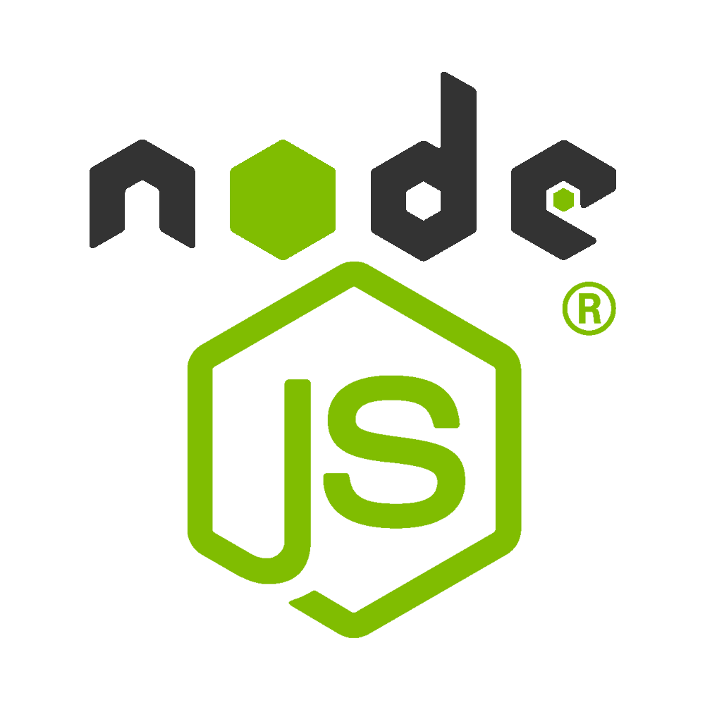
Latest News - DENO introduced in May 2020
Giant, well established & well supported unlike early staged “Deno”.
Simple, modern & secure runtime.
Built in Rust & uses V8
Secure by default & supports Typescript out of the box
Both created by Ryan Dahl and have much similarities.

Slide 15

Tricky Question ??
Can “npm” be used to update npm itself ?

Slide 16

Thank You !!
Contact us:
Varun Kumar
varun.kumar@metacube.com

